Slide 1
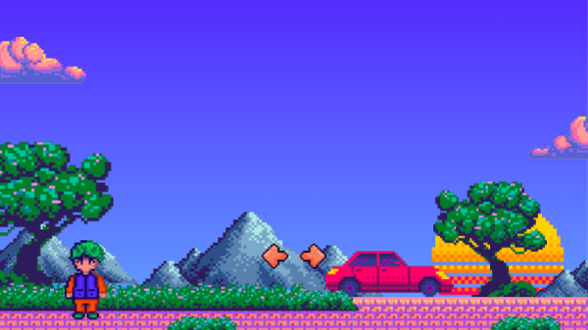
Assignment 4
Multimedia Technologies
Team: Salima Zimbekkyzy, Azhar Saparzholova, Nurassyl Oralbekov Group: SE-2623 Course: ICT

Slide 2
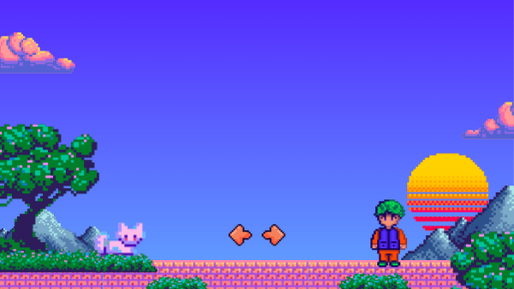
Part A — Multimedia formats

Slide 3
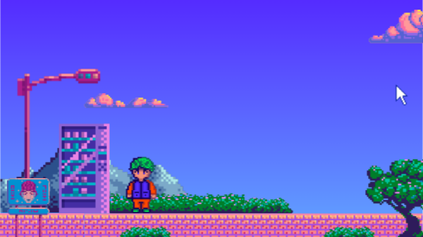
A1. Format comparison
Format
Type
Compression
Alpha / motion
Typical size
Support
Project use
PNG
Image
Lossless
Alpha; APNG
Large photos
Broad
UI evidence
JPEG
Image
Lossy
Neither
Small photos
Broad
Photos
WebP
Image
Both modes
Alpha + motion
Compact
Modern
App preview
SVG
Image
Vector / text
Alpha + motion
Tiny icons
Broad
UI icons
MP3
Audio
Lossy
N/A
Small
Broad
Speech / music
AAC (M4A)
Audio
Lossy
N/A
Small
Broad*
Narration
WAV (PCM)
Audio
Uncompressed
N/A
Large
Broad*
Editing master
MP4 H.264
Video
Usually lossy
Motion; no alpha
Bitrate-based
Broad*
Demo delivery
WebM VP9
Video
Usually lossy
Motion; alpha*
Bitrate-based
Modern*
Web playback
MOV H.264
Video
Usually lossy
Motion; no alpha
Bitrate-based
Limited web
Editing / transfer
A container (MP4) packages tracks and metadata; a codec (H.264) encodes and decodes the media.
*Codec, OS and device support vary. File size depends on content, resolution, bitrate and duration.
Sources: MDN, Image file type guide and Media container formats.

Slide 4
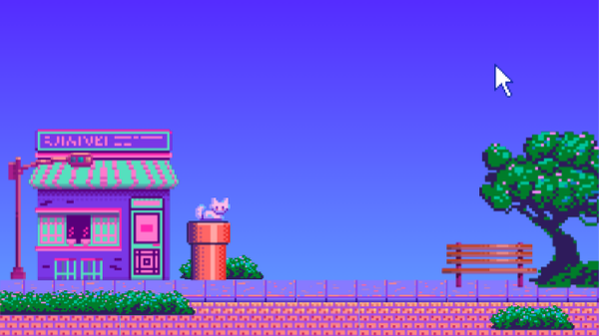
A2. Measured experiment
Project file / export
Setting and dimensions
Size (KiB)
Quality evidence
attendance-preview.png
PNG, 390 × 844 px
58.39
Original; visual check pending
attendance-preview.jpg
JPEG Q80, 390 × 844 px
Not supplied
Export + inspect
attendance-preview-low.jpg
JPEG Q40, 390 × 844 px
Not supplied
Export + inspect
attendance-preview.webp
WebP Q80, 390 × 844 px
15.75
In app; visual check pending
10-second clip, version 1
Proposed: MP4 H.264, 720p
Not supplied
Record + export
10-second clip, version 2
Same clip, lower video bitrate
Not supplied
Compare text and motion
42.64 KiB saved per preview
58.39 → 15.75 KiB: 73.0% smaller at the same resolution.
Source: supplied project inventory, 23 Oct 2026. 1 KiB = 1024 bytes.
JPEG and clip rows are a test plan, not completed measurements.

Slide 5

A2. Visual quality check
What the quality comparison must show
Use the same attendance screen in all four exports. Compare an identical crop at 100% zoom so text edges
and calendar lines remain comparable.
PNG
JPEG Q80
JPEG Q40
WebP Q80
Actual project crop
Actual project crop
Actual project crop
Actual project crop
required here
required here
required here
required here
Evidence still needed
One side-by-side screenshot, JPEG file sizes, and two exports of the same 10-second clip. Rate each result as
sharp, acceptable or poor after inspection.
The source image and recording were not included in the supplied files. These boxes mark missing evidence.

Slide 6
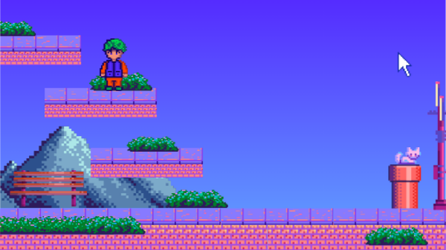
A2. Our format choices
73%
For the My AITU / LMS bridge, we use WebP at quality 80 for the
attendance preview. At the same 390 × 844 resolution, its file size
falls from 58.39 KiB to 15.75 KiB, saving 42.64 KiB, or 73.0%. We
smaller preview file
retain PNG as the original evidence image because it preserves text
and edges without lossy compression. Inline SVG suits interface icons
because vectors stay sharp at different sizes and share the HTML
response. CSS provides the login pulse without a separate video
Same pixels. Less data.
download. For the project demonstration, we plan MP4 with H.264
video and AAC audio for broad playback support. JPEG settings and
PNG 58.39 KiB
the ten-second clip still need measured comparison before we can
WebP 15.75 KiB
report their quality or size.
Measured file sizes only.
Network speed needs its own test.

Slide 7
B1. Interface icons
#
Asset
Where used
Vector viewBox
Markup size
3
Book
Courses / navigation
SVG 300 × 300
740 B
4
Calendar
Tasks / attendance
SVG 300 × 300
1,162 B
5
Graduation
Grades
SVG 300 × 300
857 B
6
User
Account button
SVG 300 × 300
869 B
7
Menu
Navigation button
SVG 300 × 300
561 B
8
Close
Navigation controls
SVG 300 × 300
441 B
9
Down
Account menu
SVG 300 × 300
391 B
10
Sign-out
Account menu
SVG 300 × 300
906 B
11
Refresh
Reload
SVG 300 × 300
945 B
12
Search
Course search
SVG 300 × 300
669 B
13
Eye
Password visibility
SVG 300 × 300
935 B
14
Check
Attendance
SVG 300 × 300
366 B
All icons: Flaticon Uicons Regular Rounded. Free licence with visible footer attribution.
Inline symbols share the HTML response; these are source sizes, not separate requests.

Slide 8
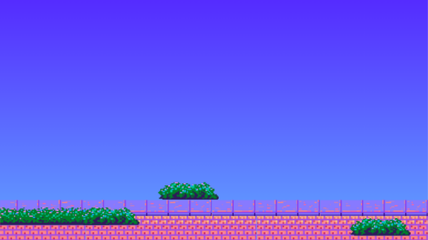
B1. Media asset inventory
#
Asset
Where used
Format / dimensions
Size
Source / licence
15
Absent icon
Attendance
SVG 300 × 300
442 B
Flaticon¹
16
Clock icon
Attendance time
SVG 300 × 300
777 B
Flaticon¹
17
Minus icon
Unmarked attendance
SVG 300 × 300
284 B
Flaticon¹
18
Left arrow icon
Previous month
SVG 300 × 300
416 B
Flaticon¹
19
Next arrow icon
Next month
SVG 300 × 300
404 B
Flaticon¹
20
List icon
Attendance status
SVG 300 × 300
1,010 B
Flaticon¹
1
Attendance preview
Sign-in
WebP 390 × 844
15.75 KiB
Own + icons¹
2
LMS wordmark
Sign-in
CSS / text, 68 × 68
Embedded
Own
21
Login pulse
Login progress
CSS, 2 s loop
Embedded
Own
22
Entrance motion
Transitions
CSS, 0.4 s
Embedded
Own
23
Campus map
Map section
Responsive iframe
Variable
Yuujiso / MIT²
24
Inter font
Interface text
Web font / weights
Variable
Inter / OFL³
25
Remote view
Optional support
JPEG Q70, 1100 × 800
Variable
Private session
¹ Flaticon attribution in footer. ² github.com/Yuujiso/aitumap (MIT), author beside map.
³ github.com/rsms/inter (SIL OFL 1.1). Remote session views must stay out of the submitted demo.
Unused ui-right / ui-stats and evidence PNG files are not loaded by the running interface.

Slide 9
B2. Integration and optimisation
What is integrated
WebP preview: 390 × 844 px, displayed at 250 px wide.
18 inline SVG icons and a CSS login pulse.
Reduced-motion preference disables animation.
The full page still needs a 360 px browser check.
Controlled local payload
Before: PNG
After: WebP
Change
Preview image
59,787 B
16,126 B
−73.0%
4 front-end files + preview
141,601 B
97,941 B
−30.8%
DevTools measurements: still required
Disable cache, select Fast 4G, reload the same screen before and after. Capture transferred bytes, request count and
Finish/Load time. Image-request delta should be 0; verify the total.
The payload calculation excludes headers, compression, API, fonts and map traffic. Stage 1 requires <3 s per request at 1,000
users; this remains unverified.

Slide 10
B3. Accessibility of media
Meaningful images have descriptive alt text
The test attendance preview describes the month and status counts. Decorative SVGs use aria-hidden="true";
controls retain text or accessible labels.
<img src="/attendance-preview.webp" width="390" height="844"
alt="Тестовый экран посещаемости: календарь за октябрь 2026 года
и счётчики — 0 присутствий, 1 пропуск, 0 опозданий,
1 запись без отметки.">
Motion follows the user’s preference
@media (prefers-reduced-motion: reduce) {
*, *::before, *::after { animation: none !important;
transition: none !important; scroll-behavior: auto !important; } }
No speech media or sound playback: captions and sound equivalents are currently N/A.
Progress is visible as text and a pulse. No live text sits over raster images, so the
4.5:1 text-over-image test is N/A. Source: supplied part_b.md, B3.

Slide 11
Part C — Multimedia presentation

Slide 12
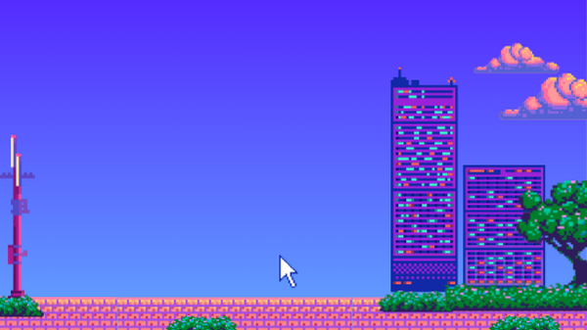
C1. Storyboard
Duration
What is on screen
Narration
0:00-0:30
Login screen
Nurassyl: How login proccess looks
0:30-1:10
Main pages, burger-menu, references from stage 1
Salima: Website content and design desecions
1:10-1:40
Statistics, survey from stage 1
Azhar: the purpose of project
1:40-2:10
Demo sketches
Azhar: Future of the project

Slide 13
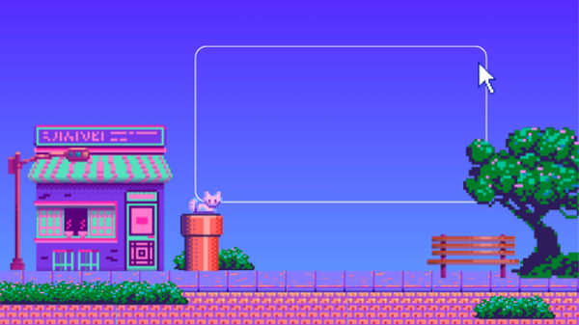
C2. The video
https://drive.google.com/drive/folders/1izH4jyb1Ooi-pvghCGhOfCXmk6A6rqKn?usp=sharing

Slide 14
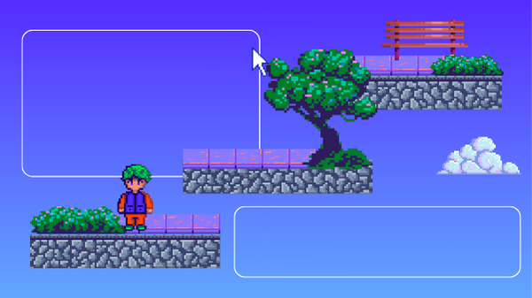
C3. Production note
In 80–120 words, state the tools you used to record and edit, and your export settings — container, codec, resolution, frame rate, bitrate and final file size — and explain why you chose them rather than a higher or lower setting.

Slide 15
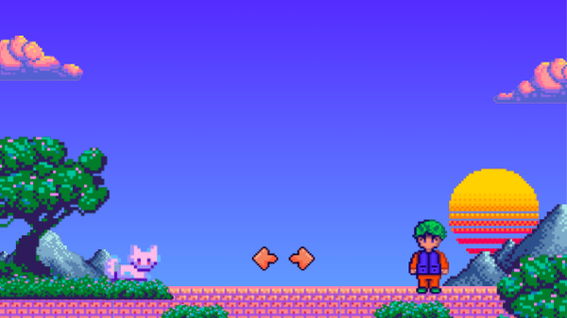
Part D — Integration with the project

Slide 16
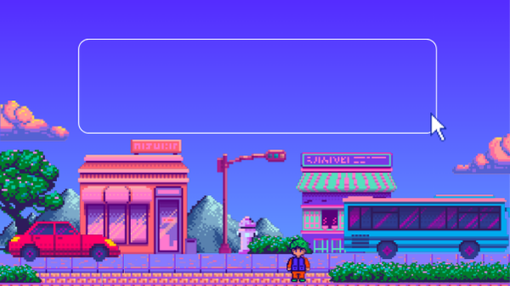
D1. Updated prototype
https://github.com/d30mantcoder/ICTProject
Git clone it Create virtual environment Install dependencies (requirements.txt) Run bridge-test/app.py via python

Slide 17

D2. Change log
Change
Reason
Status
Added fetching from LMS
To make the website usable
Using real LMS data
Redesign of UX of LMS
UX of original LMS was uncomfortable
Most useful buttons takes place on the main page
Added asynchronius sessions
It was impossible to work for more than 1 person at the same time before
Server handles multi-user sessions

Slide 18
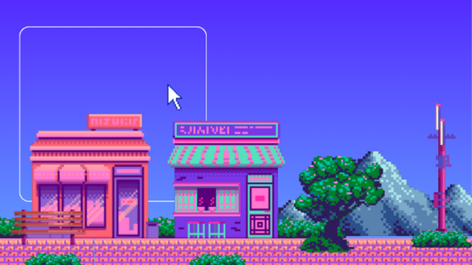
Members
Parts
Contribution
D3.
Salima
C,D
Editing the video
contribution table
Azhar
A,D
Comparing the multimedia formats
Nurasyl
B,D
Integration and optimization of multimedia

Slide 19
Thank You

